Slide 1
Node.js Programming on Ubuntu
Rashmi Purandare

Slide 2
Table of content
How to install Ubuntu
Setup Ubuntu on MacBook virtually
Configuration
How to install JDK on Ubuntu
Set up Java Path
How to check Ubuntu version
How to install & uninstall Nodejs on Ubuntu
How to set up time server
Understanding JSON?
Understanding HTTP JSON API Server

Slide 3
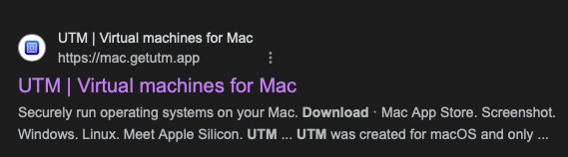
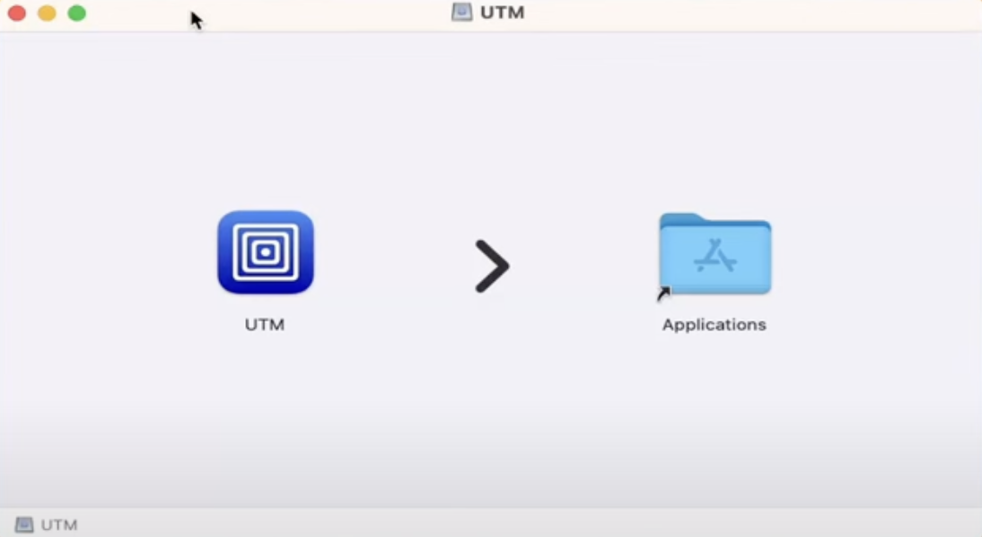
How to install Ubuntu 24.04 on Mac OS virtually.
Download & Install UTM
Here we will use a tool called UTM virtual machine for MacBook.
Firstly, we will install UTM on you Mac which runs securely on the OS.

Slide 4
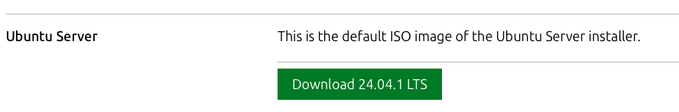
Download Ubuntu ARM
After installing UTM, we will download the ARM image of Ubuntu 24 since MacBook supports the ARM architecture.
On clicking below link you will be able to download Ubuntu server for ARM https://ubuntu.com/download/server/arm

Slide 5
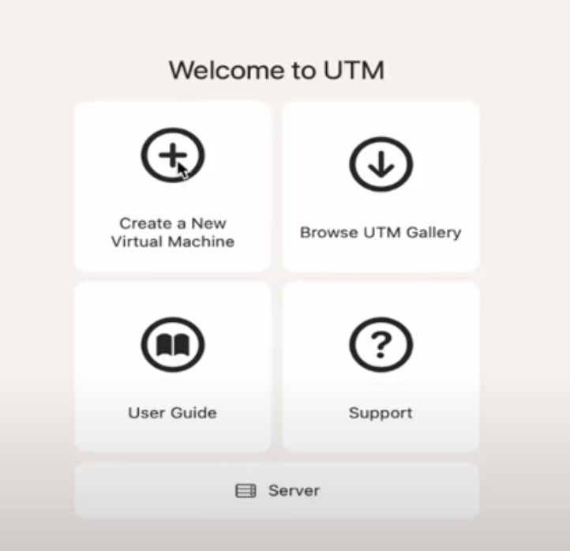
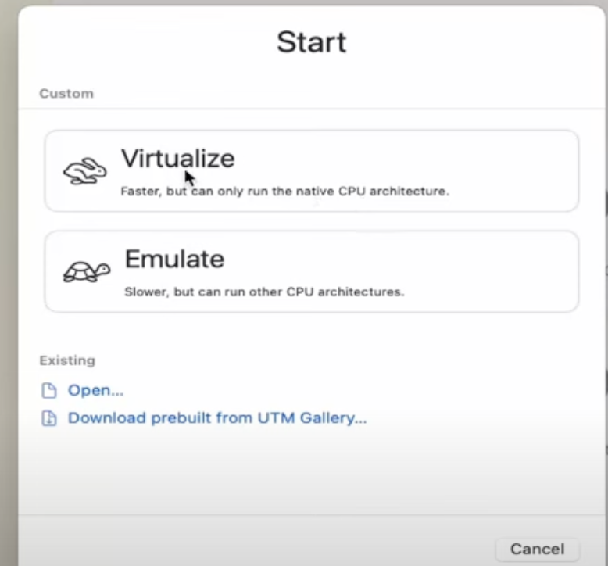
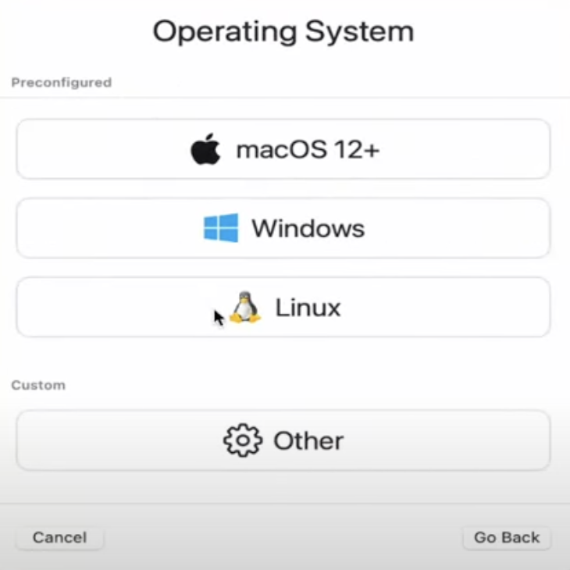
Creating New Virtual Machine in UTM
Open UTM application now and select create new Virtual Machine then select virtualize option and then select Linux OS.
Then, browse the downloaded ARM file and select it.
Allocate sufficient resources (CPU, RAM) to the virtual machine to ensure smooth performance and select any shared directory from your system eg. Downloads so that file transferring will be easy between Ubuntu and Mac.

Slide 6
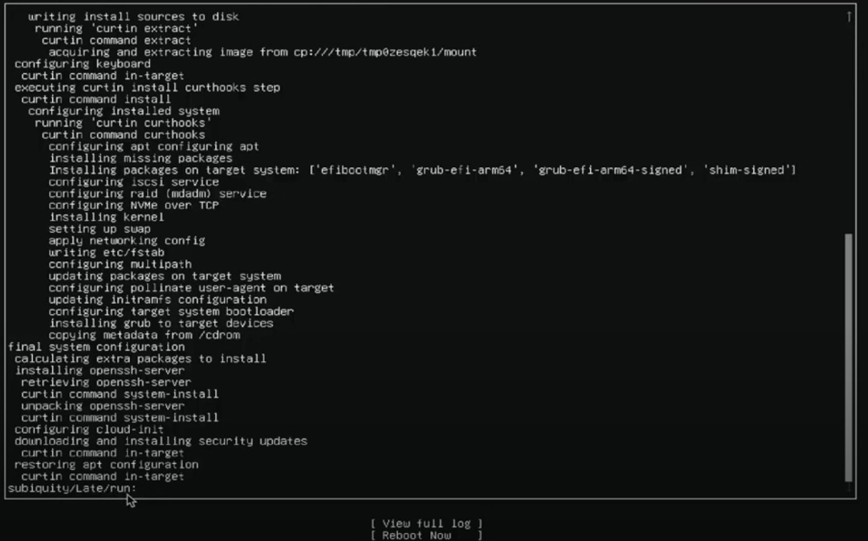
Install Ubuntu 24.04 LTS
Start the virtual machine and follow the on-screen instructions to install Ubuntu 24.04 LTS.
Complete the installation process, setting up your user account and preferences.
Once you reach the below screen , the installation is completed and you can click on reboot.

Slide 7
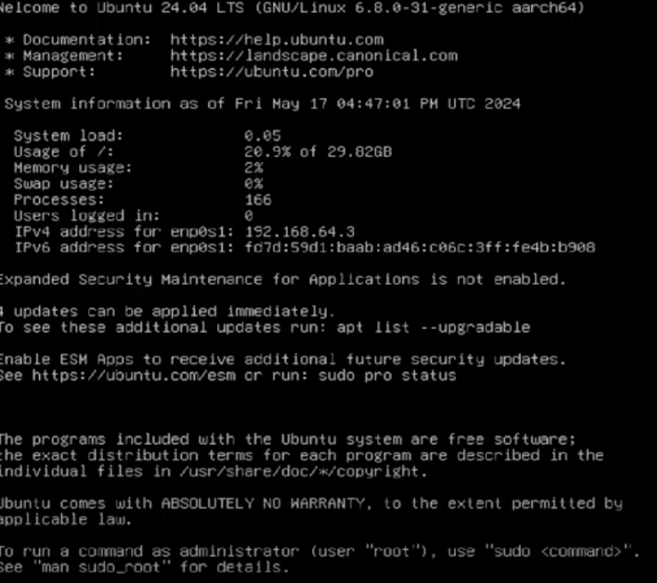
Set Up GUI for Ubuntu
Once you restart and enter your credentials you will be logged in to the Ubuntu server and below screen will be displayed.

Slide 8
Commands to set up the GUI and Desktop
sudo apt update : It fetches the latest package lists from the repositories, ensuring that you can install the latest versions of software and dependencies.
sudo apt install tasksel : A utility that simplifies the installation of predefined tasks in Ubuntu
sudo apt install ubuntu-desktop : This command installs the Ubuntu desktop environment (GUI) if it's not already installed. It includes the graphical interface and necessary software packages to provide a full desktop experience.
sudo reboot now : This command restarts your virtual machine so that the changes (like the installation of the desktop environment) can be applied.

Slide 9
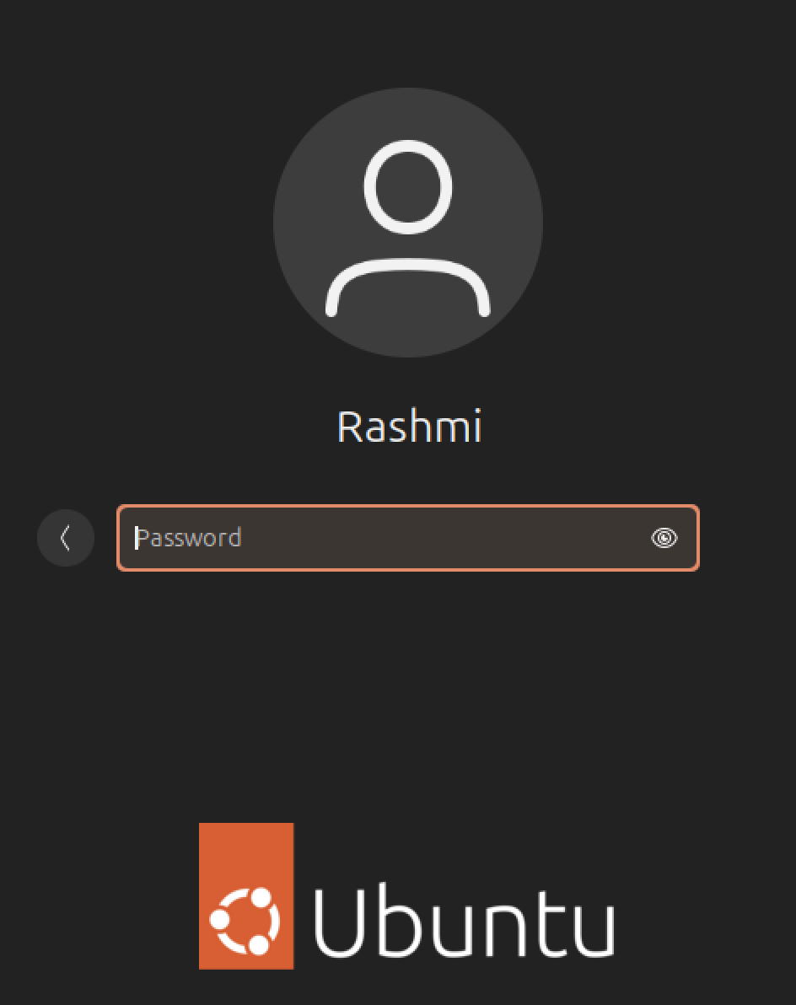


Once you restart, you will be directed to the Graphical User Interface.
Login with your credentials.
Run below command for better integration and then reboot again.

Slide 10
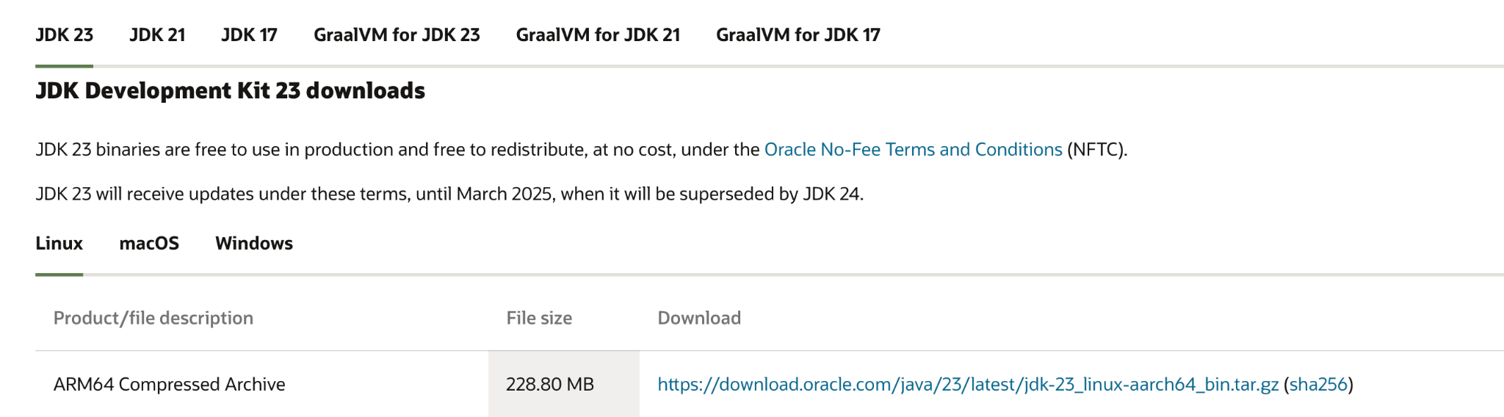
Download Oracle JDK
Open your web browser and navigate to the Oracle JDK Downloads page https://www.oracle.com/java/technologies/downloads/
Find the section for JDK and select the appropriate package for your system.
Accept the Oracle license agreement and download the file to your computer.
Here we install the ARM package since installed Ubuntu is also ARM compatible.

Slide 11
Installing JDK on Ubuntu
Open the terminal and navigate to the directory where you downloaded the JDK file.
Select the downloaded file and extract it using below commands
tar -xvf jdk-23_linux-aarch64_bin.tar.gz : Extracts the file
sudo dpkg -i jdk-23_linux-aarch64_bin.deb : Installs the extracted file.
To confirm JDK23 was installed correctly you can use the command
java -version

Slide 12
Set up JAVA Path
You can set up Java Path by two ways :
Temporary Path | Permanent Path
A temporary path is set for the current session only. Once you close the terminal or log out, the changes will be lost | A permanent path is set in a configuration file (like ~/.bashrc, ~/.bash_profile) and remains in effect even after closing the terminal or logging out.
Useful for testing or running a single command without modifying system-wide settings | Ideal for setting up environment variables that need to be accessible every time you open a new terminal session.
export JAVA_HOME=/usr/lib/jvm/java-<version> | export JAVA_HOME=/usr/lib/jvm/java-<version> export PATH=$JAVA_HOME/bin:$PATH

Slide 13
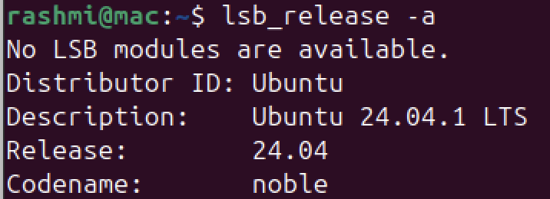
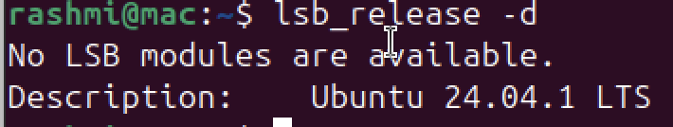
Checking Ubuntu Version
After opening the terminal, use the lsb_release -a command to check the Ubuntu version.
Instead of printing all of the above information, you can display the description line, which shows your Ubuntu version passing the -d switch.

Slide 14
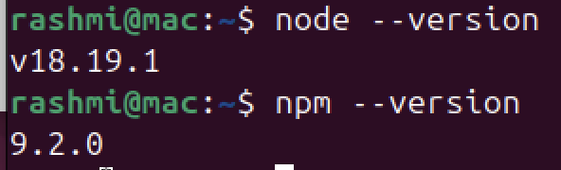
Installation and Uninstallation of Node.js
For installing Node.js, enable the NodeSource repository by running the following curl
For node.js version 19.x
$ curl -sL https://deb.nodesource.com/setup_19.x | sudo -E bash -
Followed by $ sudo apt install nodejs and $ sudo apt-get install -y nodejs for npm (Node Package Manager)
Verify that the Node.js and npm were successfully by using below commands
$ node --version
$ npm --version
If you wish to uninstall Node.js from your Ubuntu system, run the command below:
sudo apt-get remove nodejs
The command will remove the package but retain the configuration files. To remove both the package and the configuration files run:
sudo apt-get purge nodejs
As a final step, you can run the command below to remove any unused files and free up the disk space:
sudo apt-get autoremove

Slide 15
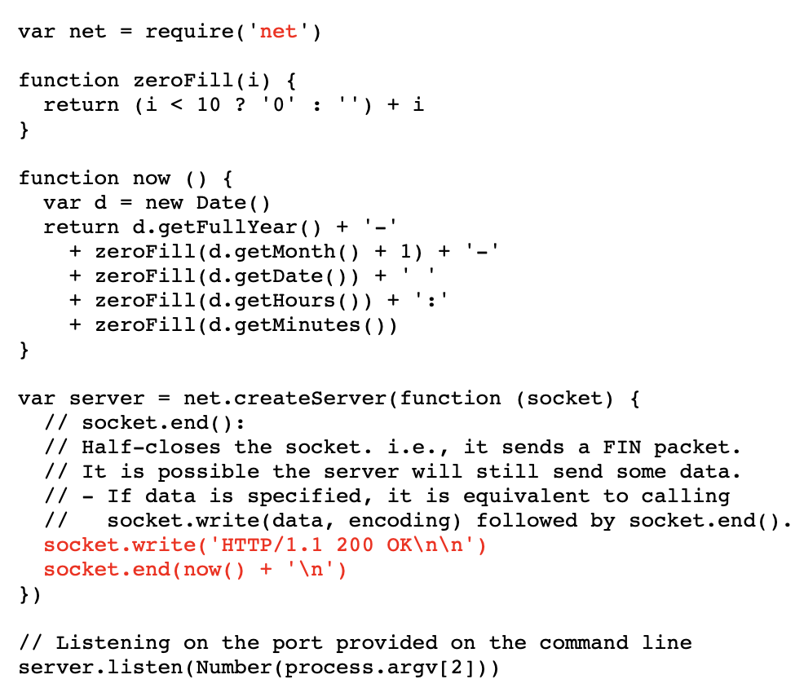
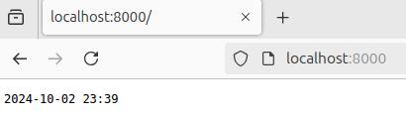
How to set up Time Server on Ubuntu
After installing node.js, create a JavaScript file that contains the code for the time server. Then, save the code in a file called time_server.js. nano time_server.js
Open the terminal and navigate to the directory where time_server.js is saved.
Start the server by providing the port number as the first argument. For example, to run the server on port 8000 by using the command node time_server.js 8000
On the client browser enter http://localhost:8000/ to get the below output.
JavaScript
Output

Slide 16
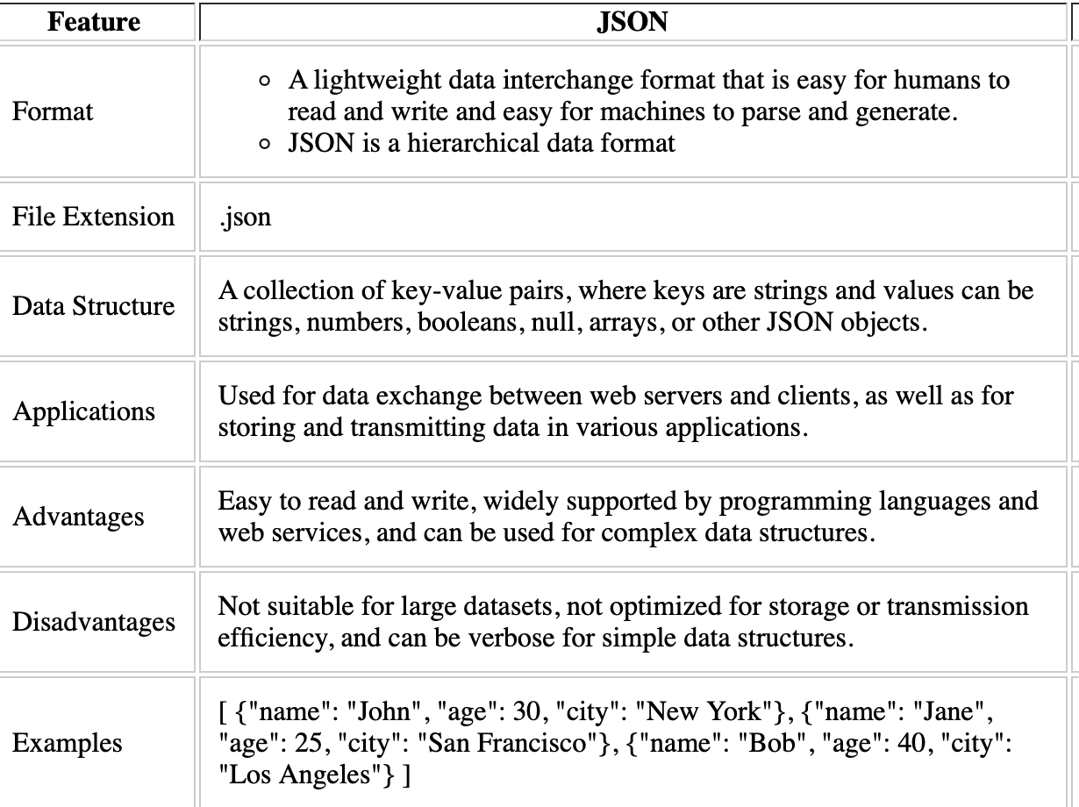
Understanding JSON (JavaScript Object Notation)
A text-based open standard designed for human-readable data interchange.
Derived from the JavaScript scripting language, JSON is a language for representing simple data structures and associative arrays, called objects.
Despite its relationship to JavaScript, JSON is language-independent, with parsers available for many languages.

Slide 17
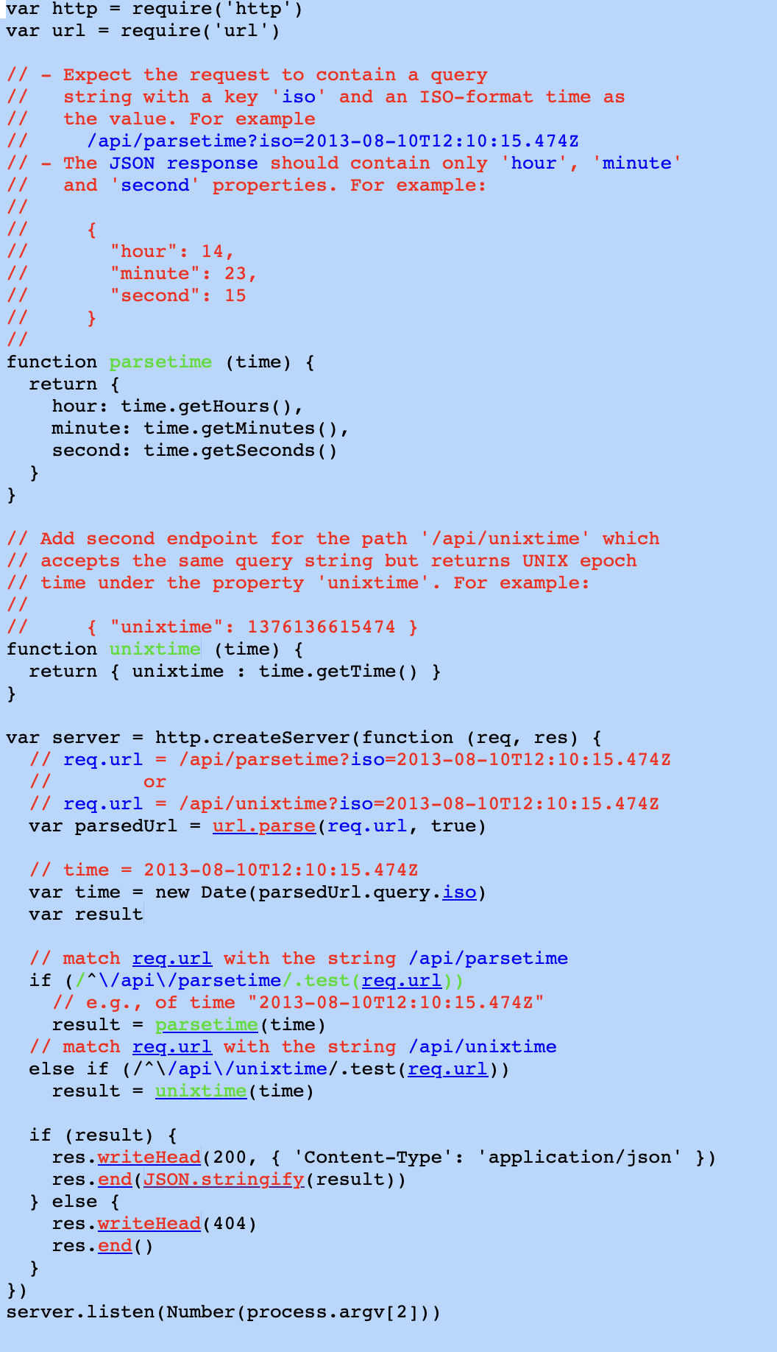
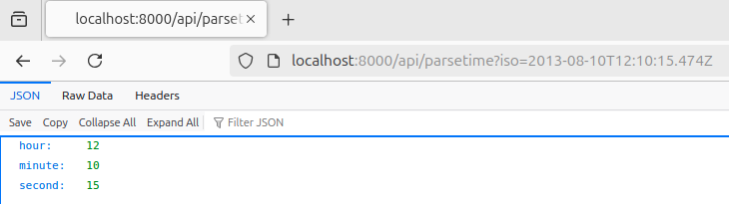
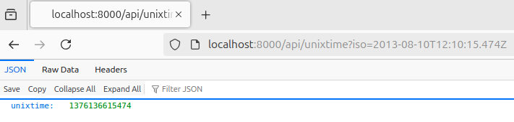
Understanding HTTP JSON API Server
-Let’s consider below question.
Create an HTTP server in Node.js that responds with JSON data.
The server should handle two specific endpoints:
/api/parsetime: The client will send a query string with an ISO-format date (e.g., ?iso=2013-08-10T12:10:15.474Z), and the server should return the hour, minute, and second from that date as a JSON object.
/api/unixtime: The server should return the UNIX timestamp (epoch time) for the same ISO-format date.
The server should listen on a port passed as the first argument when you run the program.
Step 1: On the server use below command $ node http_json_api_server.js 8000
Step 2: on the client browser enter http://localhost:8000/api/parsetime?iso=2013-08-10T12:10:15.474Z
Step 3: on the client browser enter http://localhost:8000/api/unixtime?iso=2013-08-10T12:10:15.474Z
Output

Slide 18
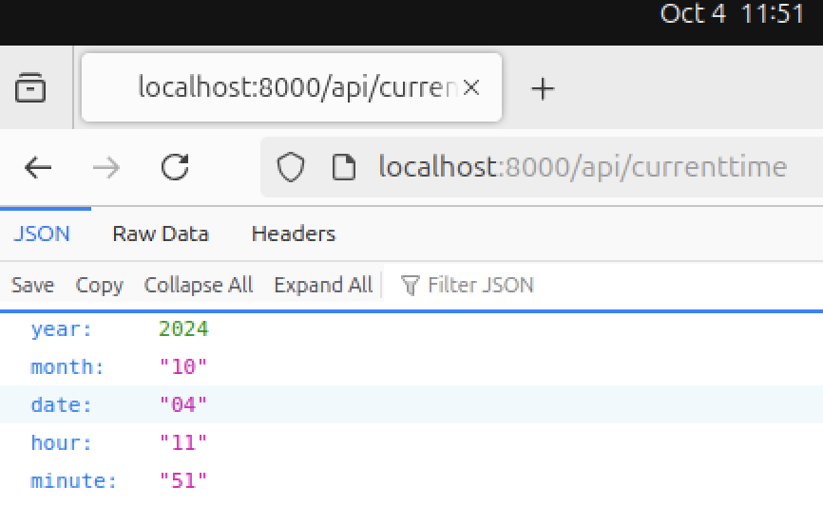
Modifying HTTP JSON API Server to get the current time
We will get the current time by modifying the JSON file previously used . Few changes in the parsetime() function will give us our required output.
function parseTime(time) {
return {
year: time.getFullYear(),
month: String(time.getMonth() + 1).padStart(2, '0'), // Months are 0-based
date: String(time.getDate()).padStart(2, '0'),
hour: String(time.getHours()).padStart(2, '0'),
minute: String(time.getMinutes()).padStart(2, '0') }; }
And then adding below logic.
// Handle /api/parse_currentime
else if (/^\/api\/parse_currenttime/.test(req.url)) {
var currentTime = new Date(); // Get the current time
result = parseCurrentTime(currentTime); // Use the current time parsing function }
On the client browser enter:
http://localhost:8000/api/currenttime
Output

Slide 19


